Slide 1
Ch04_Thread Concepts

Slide 2
Contents
01_Introduction
02_Definition of Thread
03_Motivation for Thread
04_Thread States : Life Cycle of a Thread
05_Thread Operations
06_Threading Models
07_Thread Implementation Considerations
08_POSIX and Pthreads
09_LINUX Threads
10_Windows XP Threads

Slide 3
01_Introduction
Early operating systems
Enabled computers to execute several programs concurrently but does not enable programmers to specify concurrent activities
Concurrent operations were only implemented by highly experienced system programmer
In recent years
Many general-purpose programming languages, including Java, C#, Visual C++ .NET, Visual Basic .NET and Python provide concurrency primitives to the applications programmer
Concept of multi-threading
Thread : a portion of a program that execute concurrently with the other threads
Multi-threading technology: The application programmer specifies that applications contain "threads of execution"

Slide 4
02_Definition of Thread (1/2)
Thread
Is a lightweight process(LWP), shares many attributes of a process belongs to traditional process - a heavyweight process(HWP)
Means “a single thread of instructions” or thread of control”
Threads within a process
share many of the process’s resources (address space and open files)
can execute concurrently and cooperate to achieve a common goal
On a multiprocessor system, multiple threads can execute simultaneously
Threads possess a subset of the resources contained in a process
Local resources to each thread - processor registers, the stack and other thread-specific data (TSD)
Global resources to each thread - the address space of the thread belongs to the process
Depending on the thread implementation for the particular platform, threads may be managed by the operating system or by the user application that creates them
Examples : Win32 threads, C-threads, Pthreads

Slide 5
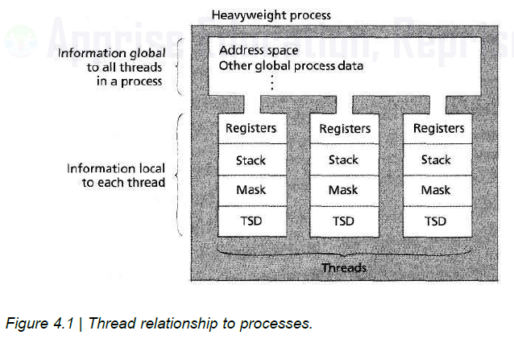
02_Definition of Thread (2/2)
Thread relationship to processes

Slide 6
03_Motivation for Thread
Motivating factors for multithreading
Software design
Due to modularity and compiler design, many applications contain segments of code that can be executed independently
Performance
Concurrent parallel execution can significantly reduce the time required for a multithreaded application to complete its task
Cooperation
A process's threads can communicate using their shared address space instead of IPC

Slide 7
04_Thread States : Life Cycle of a Thread (1/2)
Thread states in Java (similar to process)
Born State
The thread remains in the born state until the program starts it
Ready State
The thread is in the ready list
Running State
The thread obtains a processor
Dead State
Thread releases resources and it is removed from the system
Blocked State
The thread is waiting for the completion of an I/O request
Waiting State
The thread is waiting for an event (e.g., a signal from another thread)
Sleeping State
The thread is sleeping for a specified period of time (called a sleep interval)
Sleep interval is a specified period of time in the sleeping state
The thread specifies a sleep interval when it goes to sleeping state

Slide 8
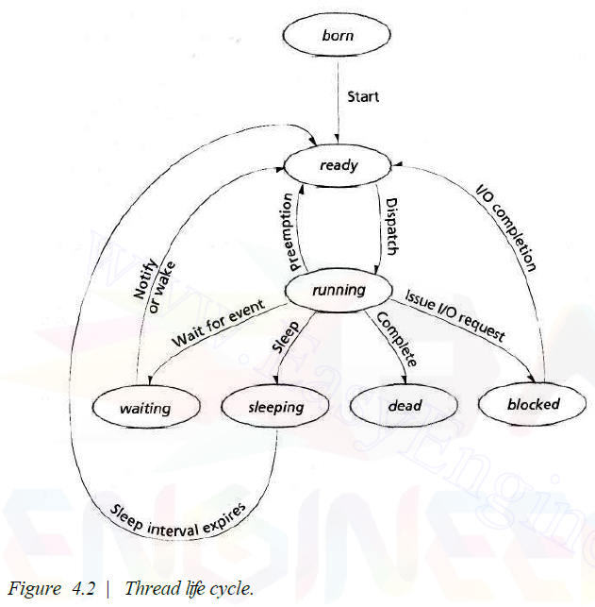
04_Thread States : Life Cycle of a Thread (2/2)
Thread Life Cycle

Slide 9
05_Thread Operations (1/2)
Threads and processes have many operations in common
Create
Similar to process creation. A process spawns a thread
Thread creation does not initialize resources that are shared between the parent process and its threads (e.g., the address space)
Thread creation is faster than process creation
Thread is sharing resources vs. Process is initializing resources
Exit (i.e., terminate)
Thread termination is often faster than process termination
Suspend
Resume
Sleep
Wake

Slide 10
05_Thread Operations (2/2)
Some thread operations do not correspond precisely to process operations (Thread operations are not in process)
Cancel
A thread or process can terminate them by canceling it
Unlike process termination, thread cancellation is not guaranteed to terminate the thread (e.g., a thread masks the cancellation signal)
※ However, a thread cannot mask an abort signal
Join
When a process is initialized, it creates a primary thread(e.g., Windows XP)
The primary thread is joined to each thread it creates
The process terminates when the primary thread returns
The primary thread typically sleeps until each thread has completed the execution
To prevent a process from terminating before all its threads complete execution

Slide 11
06_Threading Models (1/7)
Thread implementations vary among operating systems
Three most popular threading models
User-level threads
Kernel-level threads
A combination of the two (Hybrid Threading Model)

Slide 12
06_Threading Models (2/7)
User-level threads
Perform threading operations in user space
Meaning that threads are created by runtime libraries that cannot execute privileged instructions or access kernel primitives directly
Many-to-one thread mappings
The operating system maps all threads in a multithreaded process to a single execution context
Advantages
Do not require that the operating system support threads
More portable because they do not rely on a particular operating system's threading API
Application developers can tune the scheduling algorithm to meet the needs of specific applications
Do not invoke the kernel for scheduling decisions or synchronization procedures
Disadvantages
Do not scale well to multiprocessor systems, because the kernel cannot simultaneously dispatch a process's threads to multiple processors

Slide 13
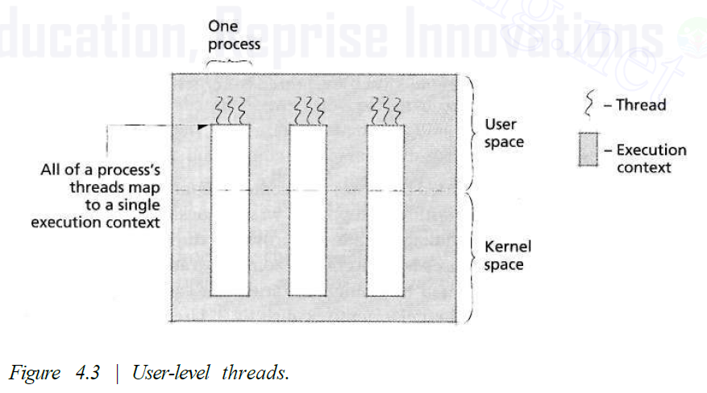
06_Threading Models (3/7)
User-Level Threads

Slide 14
06_Threading Models (4/7)
Kernel-Level Threads
Mapping each thread to its own execution context
It resolves the limitation(disadvantage) of user-level threads
Each kernel thread stores thread-specific data, such as register contents and a thread identifier
One-to-one thread mapping
Advantages :
Can dispatch a process's threads to several processors at once
Can improve performance for applications designed for concurrent execution
Can dispatch a process's ready threads even if one of its threads is blocked
Disadvantages :
Less efficient than user-level thread implementations because scheduling and synchronization operations invoke the kernel, which increases overhead
Less portable than software that employs user-level threads
Must modify the program to use the thread API for each operating system on which it runs
Consume more resources than user-level threads
Kernel-level threads are not always the optimal solution for multithreaded applications
Kernel-level threads require that the operating system manage all threads in the system

Slide 15
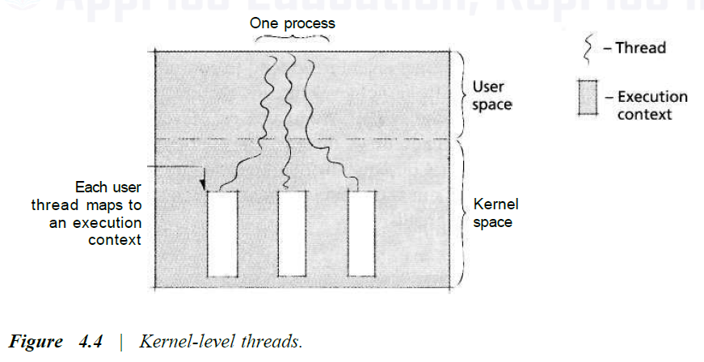
06_Threading Models (5/7)
Kernel-Level Threads

Slide 16
06_Threading Models (6/7)
Combining User- and Kernel-level Threads
The combination of the user- and kernel-level thread implementation
Many-to-many(m-to-n) thread mapping
Maps many user-level threads to a set of kernel threads
Reduce one-to-one mapping overhead by implementing thread pooling
Thread pooling
An application can specify the number of kernel-level threads it requires
Significantly reduce the number of costly thread creation and destruction operations
Worker threads
Persistent kernel threads in the pool
Kernel threads remaining in the system even after a user thread dies
Can respond to each incoming service request
Perform several different functions, depending on the threads that are assigned to them
Scheduler activation (= A kernel thread)
Can notify events to a user-level threading library
Event example - a thread is blocked or a processor is available
The user-level threading library can perform thread-scheduling operations when "activated" by an event notification

Slide 17
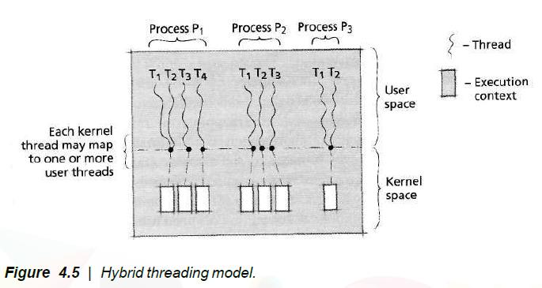
06_Threading Models (7/7)
Hybrid Threading Model
Disadvantage:
- It complicates operating system design
- There is no standard way to implement it

Slide 18
07_Thread Implementation Considerations (1/3)
Thread Signal Delivery
Two types of signals
Synchronous signal
Occurs as the direct result of an instruction executed by the process or thread
Example - an illegal memory operation, an exception
Asynchronous signal
Occurs due to an event unrelated to the current instruction
Example - notify a process of I/O completion, suspend/continue/terminate a process
A signal mask allows a thread to disable signals of a particular type, so that it does not receive signals of that type

Slide 19
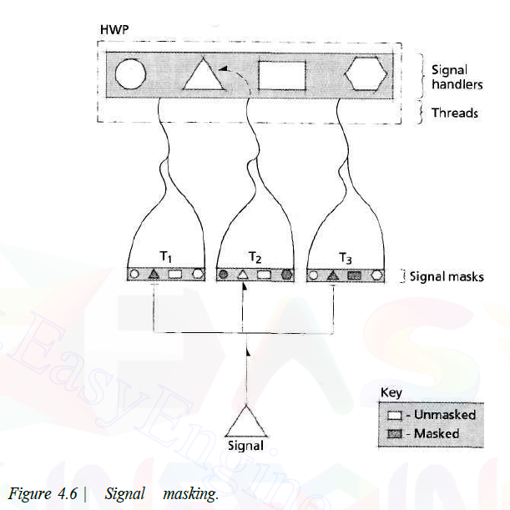
07_Thread Implementation Considerations (2/3)
Signal Masking

Slide 20
07_Thread Implementation Considerations (3/3)
Thread Termination
Thread terminates by completing execution normally (e.g., by an exit call)
OS immediately remove the thread from the system
Thread can also terminate prematurely, due to either
An exception such as illegal memory reference
A cancellation-signal from a process or thread
A thread can disable cancellation by masking the cancellation signal
e.g., completing a modification to a shared variable, this task should not be interrupted before termination

Slide 21
08_POSIX and Pthread
Portable Operating System Interface
POSIX (Portable Operating Systems Interface for uniX) is a set of standards for operating system interfaces
The POSIX specification defines a standard interface between threads and their threading library
Pthread (=POSIX Thread)
Threads that use the POSIX threading API
Pthreads can be implemented in the kernel or by user-level libraries
The processor registers, the stack and the signal mask are maintained individually for each thread, and any other resource information must be globally accessible to all threads in the process
When a thread generates a synchronous signal due to an exception such as an illegal memory operation, the signal is delivered only to that thread
If the signal is not specific to a thread, such as a signal to kill a process, then the threading library delivers that signal to a thread that does not mask it

Slide 22
08_POSIX and Pthread
Thread Cancellation Operation
Specifies a target thread to terminate
Asynchronous Cancellation Mode
The thread can be terminated at any point during its execution
Defers Cancellation Mode
The thread will not be canceled until it explicitly checks for a cancellation request
Allows a thread to complete a series of operations before being abruptly terminated
Disable Cancellation Mode
The thread is not notified that a cancellation operation has been requested

Slide 23
09_Linux Threads (1/2)
Linux thread
Many Linux kernel subsystems do not distinguish between threads and processes
Allocates the same type of process descriptor to processes and threads, both of which are called tasks
Linux uses the UNIX-based system call fork to spawn child tasks
Creating a new task that contains a copy of all of its parent's resources (e.g., address space, register contents, stack)
For threading, Linux provides a modified version of the fork system call named clone
Similar to fork, clone creates a copy of the calling task
Unlike fork, clone accepts arguments that specify which resources to share with the child process

Slide 24
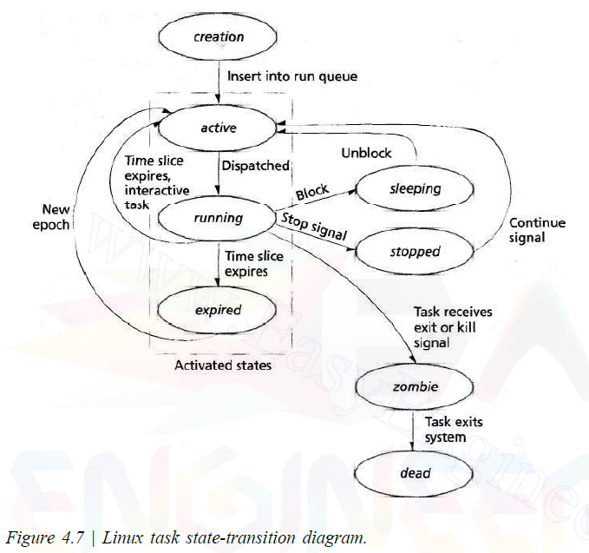
09_Linux Threads (2/2)
Linux task state-transition diagram
A task has been terminated but has not yet been removed from the system
A task is removed from the system

Slide 25
10_Windows XP Threads (1/3)
Windows XP Process
Consists of program code, an execution context, resources (e.g., open files) and one or more associated threads
The execution context includes the process's virtual address space and various attributes (e.g., security attributes)
Windows XP Threads
Are the actual unit of execution
Execute a piece of a process's code in the process's context, using the process's resources
A thread contains its process's context and
Its own execution context
Runtime stack
The state of the machine's registers
Attributes (e.g, scheduling priority)
A thread can create other threads belonging to its process
All threads belonging to the same process share that process's virtual address space
Maintain their own private data in thread local storage (TLS)

Slide 26
10_Windows XP Threads (2/3)
Windows XP Threads can create Fibers
Fibers are similar to threads except that a fiber is scheduled for execution by the thread that creates it, rather than the scheduler
Windows XP provides each process with a thread pool
Consists of a number of worker threads
Worker threads are kernel-mode threads that execute functions specified by user threads

Slide 27
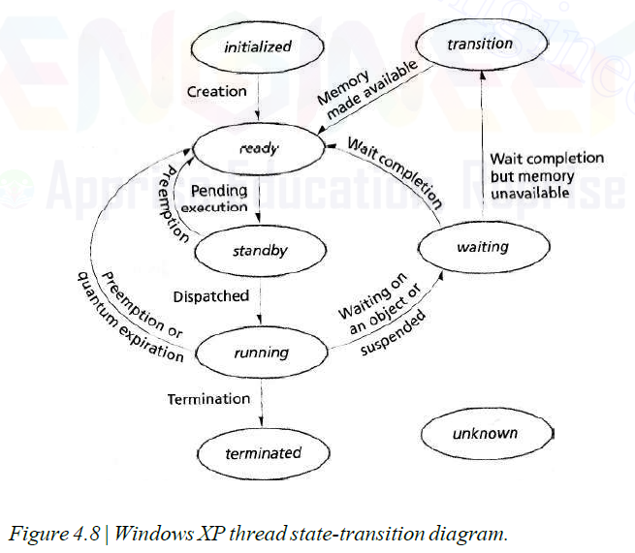
10_Windows XP Threads (3/3)
Windows XP thread state-transition diagram
During creation
Waiting to use a processor
In Context Switching
Waiting for an event
A thread completes its instructions
the thread's state is unclear (usually because of an error).
Waiting for a while just in case of re-initialization by process

